Slide 1


IBM watsonx Assistant AI-Powered Conversational Shopping Assistant
E-COMMERCE CHATBOT PROJECT
ShopEase AI: Smart Shopping Assistant
A complete, step-by-step guide to building an Intent and Entity-based AI chatbot on IBM watsonx Assistant. The bot helps customers search electronic gadgets, discover discounts, track orders in real-time, and transfer to human support when needed.
TEAM MEMBERS
Ritika Tyagi
Reg No: 12528797
Rishabh Singh Bhadouriya Reg No: 12523735
Platform: IBM watsonx Assistant (au-syd) Target Site: Retail Web Architecture

Slide 2

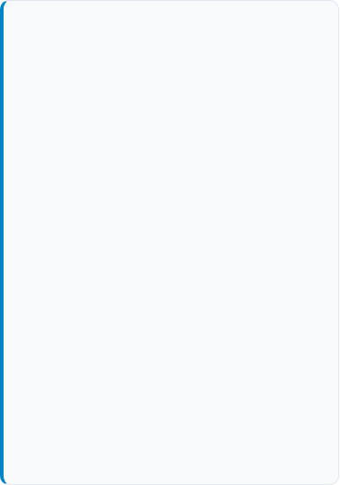
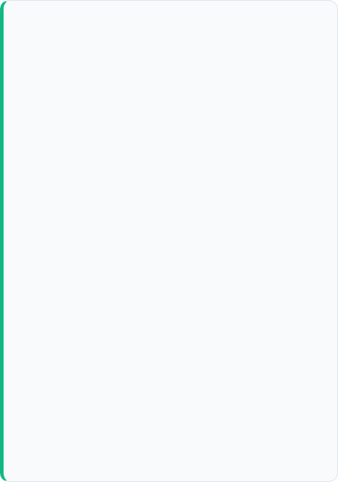
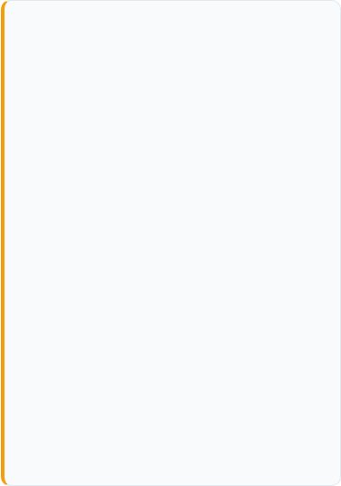



Overview
What Type of Chatbot Did We Create?
1. Intent & Entity NLU Chatbot
2. Domain-Specific E-Commerce Bot
3. Hybrid Customer Support Bot
Instead of simple yes/no buttons, this bot uses Natural Language Understanding (NLU) to understand real customer language.
Designed specifically for an Electronics Online Store to help shoppers throughout their entire buying journey.
Combines automated self-service with a smooth Human Fallback option whenever an issue is complex.
•
Intent: Understands what the user wants (e.g., finding a laptop).
•
Search: Quickly suggests phones, laptops, and headphones.
•
Automated: Answers common queries immediately.
•
Entity: Captures specific details (e.g., brand name "Dell").
•
Promotions: Shares active coupon codes and discounts.
•
Clarification: Asks users to rephrase if input is unclear.
•
Tracking: Checks delivery status with an Order ID.
•
Live Agent: Provides a 1-click "Connect to agent" button.

Slide 3

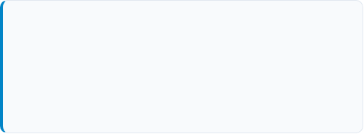

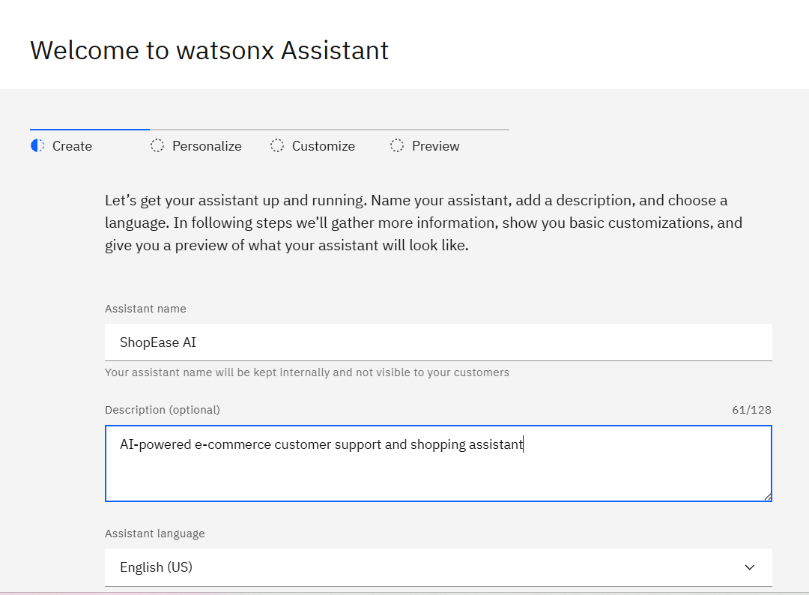

Step 1 • Initialization
Assistant Creation & Basic Setup
Creating the Assistant Profile
IBM watsonx Assistant • Create Form
We started by logging into IBM Cloud (au-syd region) and creating a new Assistant called ShopEase AI.
•
Name: ShopEase AI
•
Description: AI-powered e-commerce customer support and shopping assistant
•
Language: English (US)
Onboarding Configurations
We specified the chatbot deployment role as a developer building a web chat assistant for student capstone learning.

Slide 4

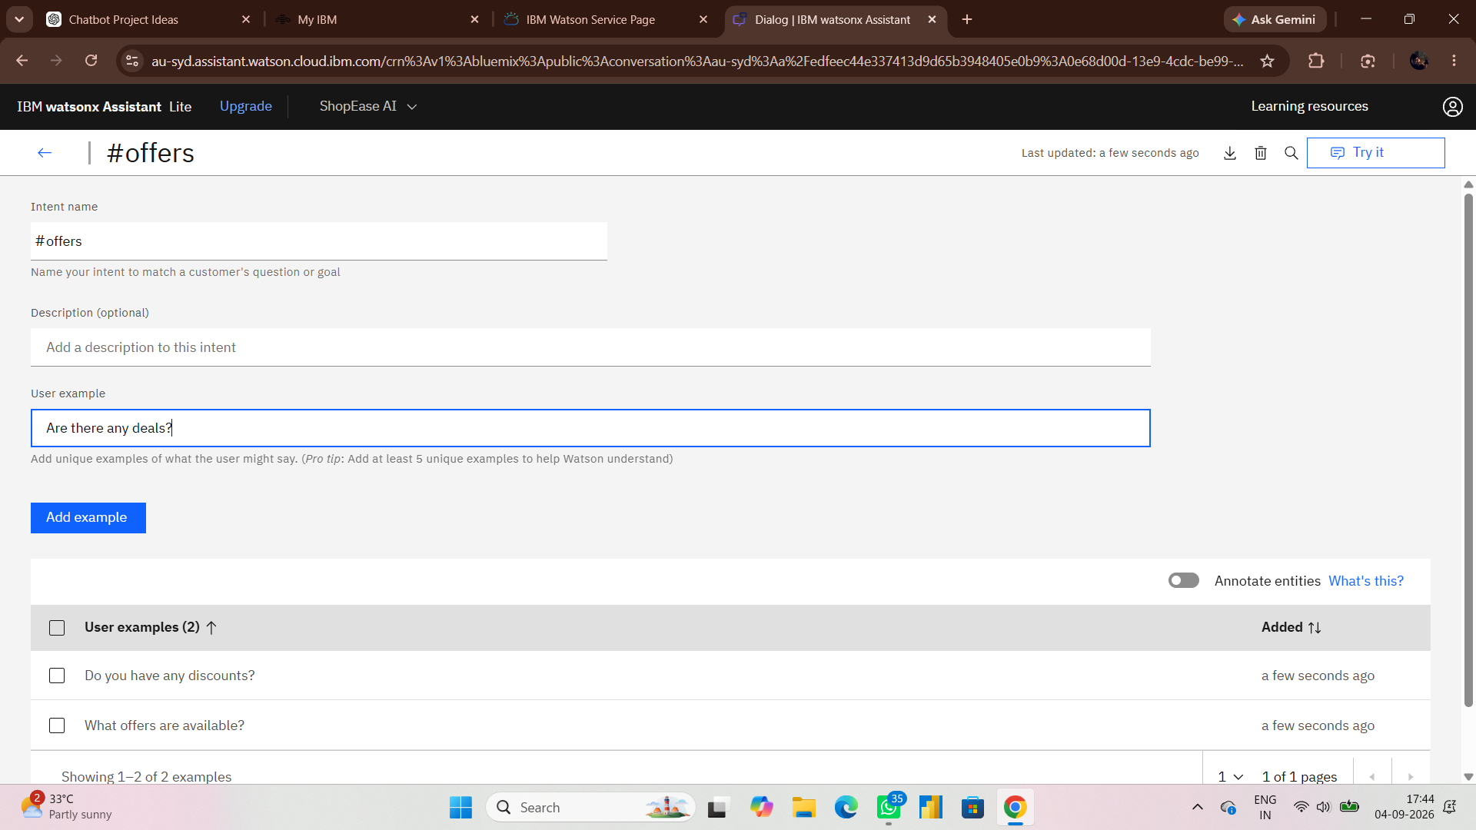






Step 2 • Training Intent Models
Defining Customer Intents (#Intents)
What is an Intent?
Watson Intent Repository • #offers Detail
An Intent represents the goal or purpose of the user’s message. We created 4 essential intents for the store:
#Greeting
User examples: "hi", "hello", "good morning"
#offers
User examples: "Are there any deals?", "What offers are available?"
#product_search
User examples: "i want to buy somthing", "looking for phone"
#track_order
User examples: "track my order", "where is my shipment"

Slide 5
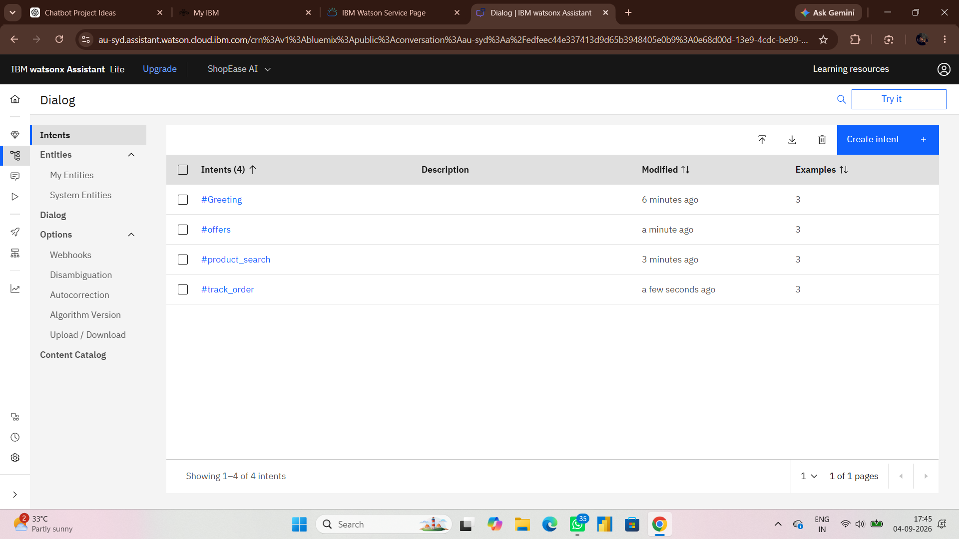
Step 2 • Training Intent Models
Defining Customer Intents (#Intents)
What is an Intent?
Watson Intent Repository • #offers Detail
An Intent represents the goal or purpose of the user’s message. We created 4 essential intents for the store:
#Greeting
User examples: "hi", "hello", "good morning"
#offers
User examples: "Are there any deals?", "What offers are available?"
#product_search
User examples: "i want to buy somthing", "looking for phone"
#track_order
User examples: "track my order", "where is my shipment"

Slide 6

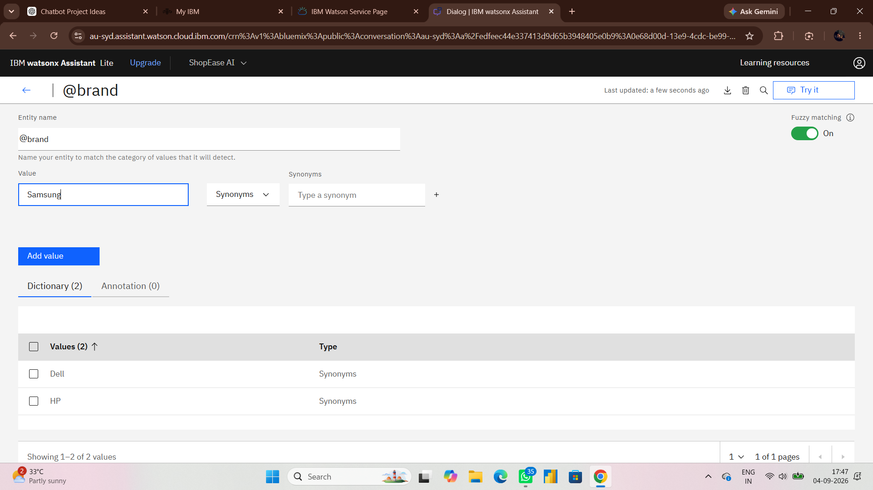




Step 3 • Parameter Extraction
Entities & Fuzzy Matching Setup
What is an Entity?
Entities Table • @brand Fuzzy Matching Toggle
An Entity extracts specific keywords and values from what the user types. This provides essential context to give the right answer.
@product
Values: laptop, phone, headphones.
@brand
Values: Dell, HP, Samsung.
@order_id
Values: ORD123, ORD456, ORD789.

Slide 7
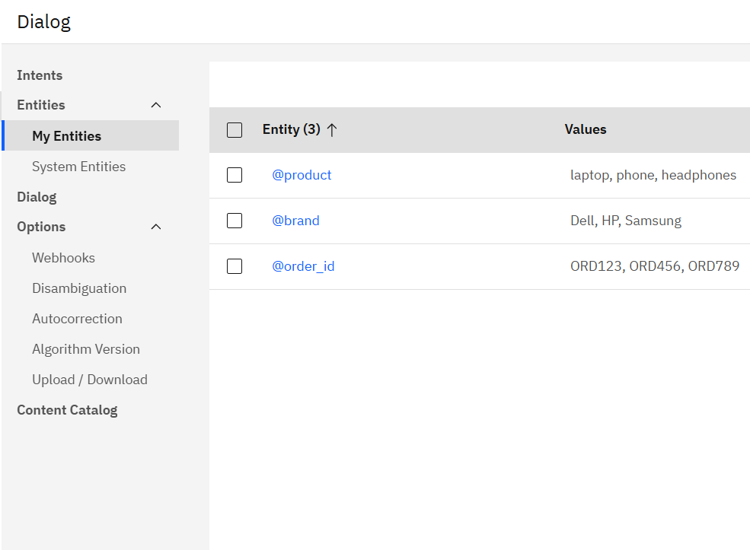
Step 3 • Parameter Extraction
Entities & Fuzzy Matching Setup
What is an Entity?
Entities Table • @brand Fuzzy Matching Toggle
An Entity extracts specific keywords and values from what the user types. This provides essential context to give the right answer.
@product
Values: laptop, phone, headphones.
@brand
Values: Dell, HP, Samsung.
@order_id
Values: ORD123, ORD456, ORD789.

Slide 8
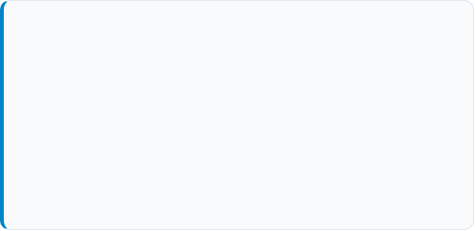
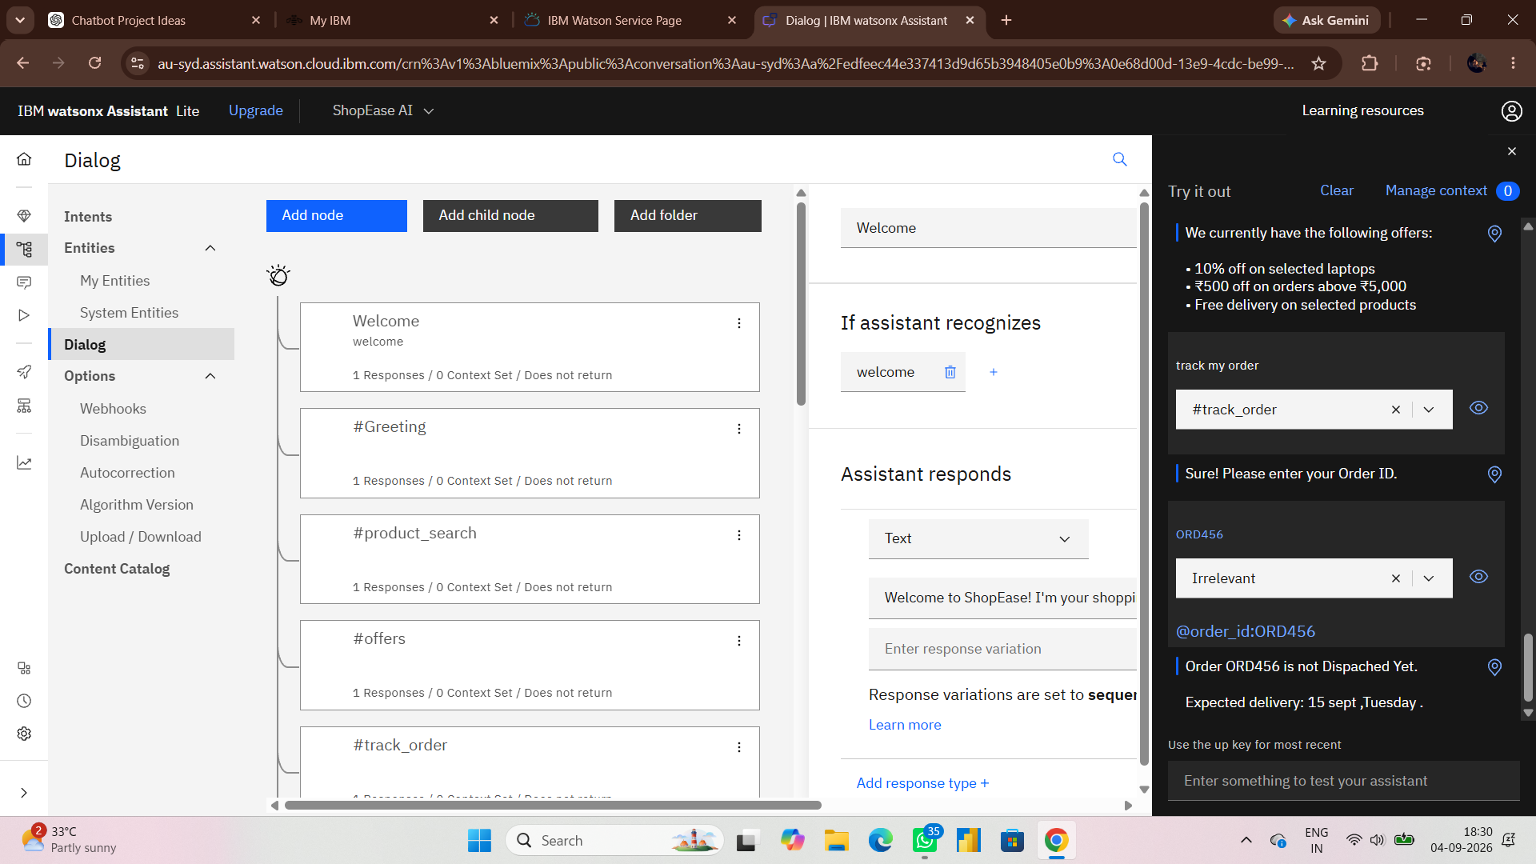

Step 4 • Conversation Logic
Dialog Flow & Logic Tree Structure
Conversation Nodes
Watson Dialog Tree • Try it out Console
The Dialog connects intents and entities to determine what the bot replies in each situation:
•
Welcome Node: Automatically greets the customer upon opening the chat widget.
•
Product Search Node: Asks which gadget the customer wants and suggests brand links.
•
Offers Node: Displays active store discounts and coupons.
•
Order Tracking Node: Asks for the Order ID and returns delivery updates.
"Try It Out" Testing Panel
Watson provides a built-in real-time testing console to verify intent recognition and entity extraction instantly.

Slide 9
Step 4 • Conversation Logic
Dialog Flow & Logic Tree Structure
Conversation Nodes
Watson Dialog Tree • Try it out Console
The Dialog connects intents and entities to determine what the bot replies in each situation:
•
Welcome Node: Automatically greets the customer upon opening the chat widget.
•
Product Search Node: Asks which gadget the customer wants and suggests brand links.
•
Offers Node: Displays active store discounts and coupons.
•
Order Tracking Node: Asks for the Order ID and returns delivery updates.
"Try It Out" Testing Panel
Watson provides a built-in real-time testing console to verify intent recognition and entity extraction instantly.

Slide 10
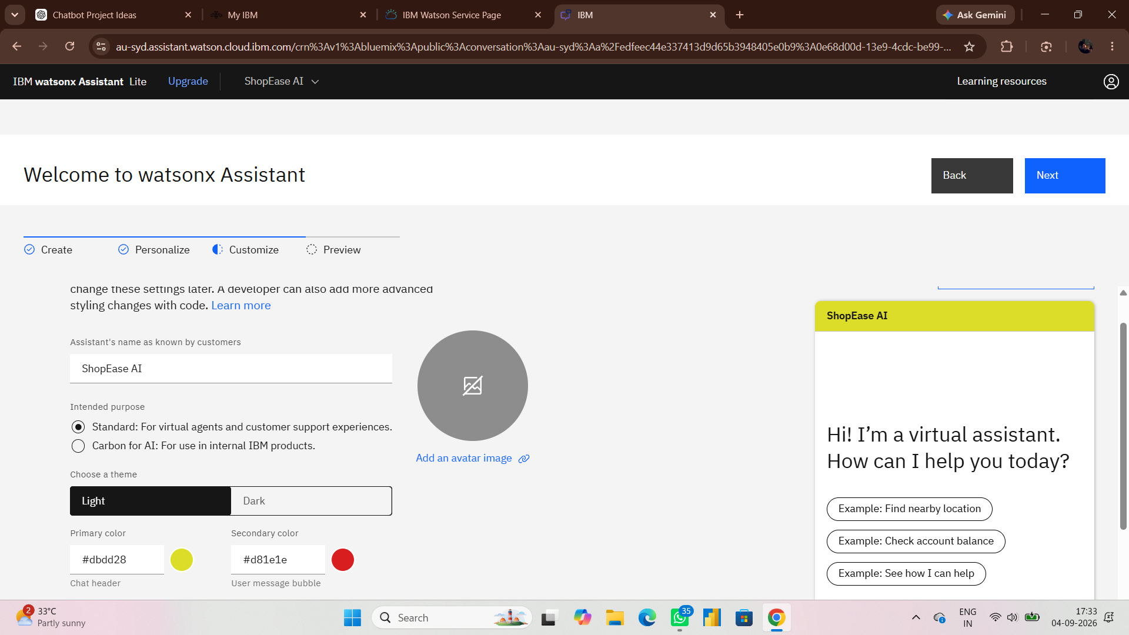



Step 5 • Visual Branding
Web Chat UI Styling & Colors
Storefront Theme Design
IBM Customize UI • Style Settings
To match an active retail shopping theme, we configured the Web Chat UI with custom brand colors:
Primary Header #dbdd28 (Lime)
User Bubble #d81e1e (Red)
Chat Title & Theme
•
Name: ShopEase AI
•
Base Theme: Light Mode (crisp readability)
•
Quick Action Chips: One-tap guidance buttons

Slide 11

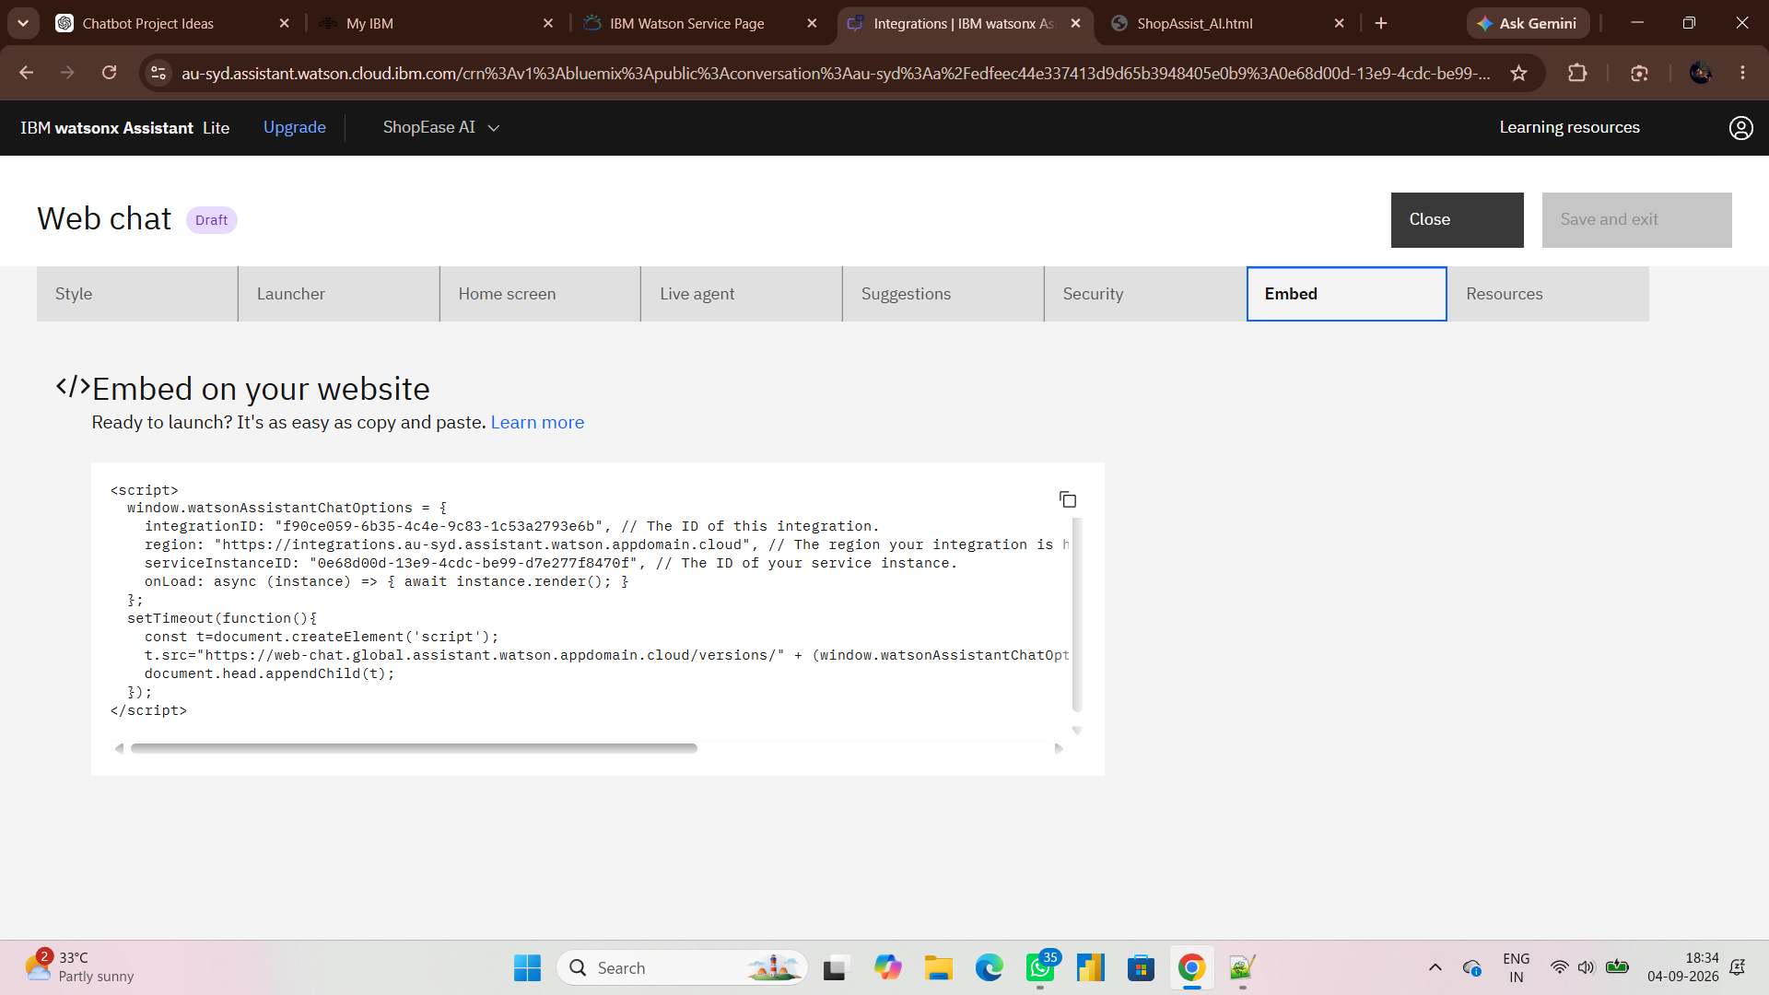
Step 6 • Code Generation
Embed Code Generation & Notepad Setup
Generating the Web Chat Script
Notepad++ • ShopAssist_AI.html Source Code
Under the Embed tab in IBM watsonx Assistant, Watson provides a lightweight JavaScript snippet to place on any website.

Slide 12
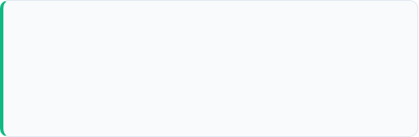
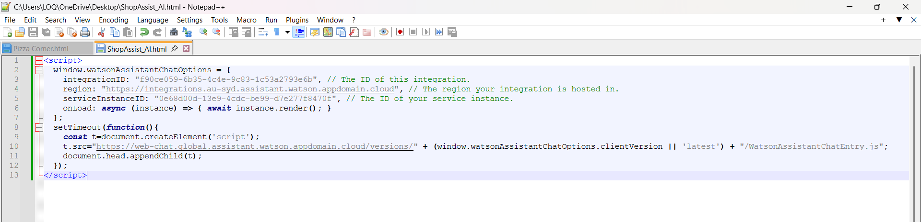
Step 6 • Code Generation
Embed Code Generation & Notepad Setup
Creating ShopAssist_AI.html
We opened Notepad++ and created a clean HTML file containing the integration keys:
Notepad++ • ShopAssist_AI.html Source Code
•
Integration ID: f90ce059-6b35-4c4e...
•
Region: au-syd (Sydney)
•
Service Instance ID: 0e68d00d-13e9...

Slide 13
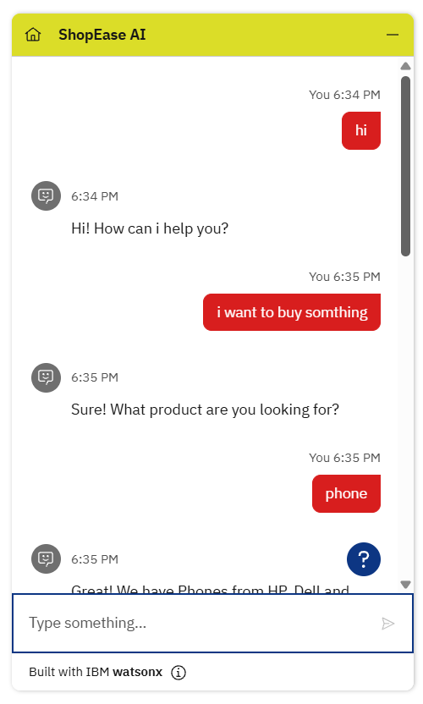
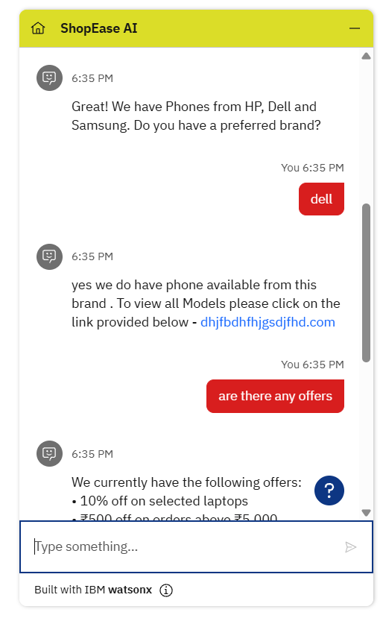

Step 7 • Testing & Execution
Runtime Testing: Product Search & Order Tracking
Testing Real Conversations
Live Chat Window • Real Conversation Test
We launched ShopAssist_AI.html in Google Chrome to test the conversation flows end-to-end:
1. Product Search:
User: "i want to buy something" Bot asks for category User: "dell phone" Bot returns brand catalog link.
2. Promotional Offers:
User: "are there any offers" Bot returns 10% off laptops, ₹500 off orders over ₹5,000, and free shipping.
3. Order Status Tracking:
User: "track my order" Bot asks for Order ID User gives ORD789 Bot confirms: "Delivered Today".

Slide 14
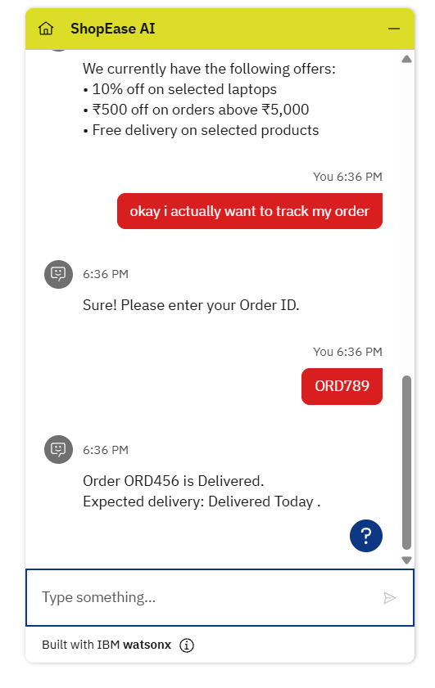
Step 7 • Testing & Execution
Runtime Testing: Product Search & Order Tracking
Testing Real Conversations
Live Chat Window • Real Conversation Test
We launched ShopAssist_AI.html in Google Chrome to test the conversation flows end-to-end:
1. Product Search:
User: "i want to buy something" Bot asks for category User: "dell phone" Bot returns brand catalog link.
2. Promotional Offers:
User: "are there any offers" Bot returns 10% off laptops, ₹500 off orders over ₹5,000, and free shipping.
3. Order Status Tracking:
User: "track my order" Bot asks for Order ID User gives ORD789 Bot confirms: "Delivered Today".

Slide 15

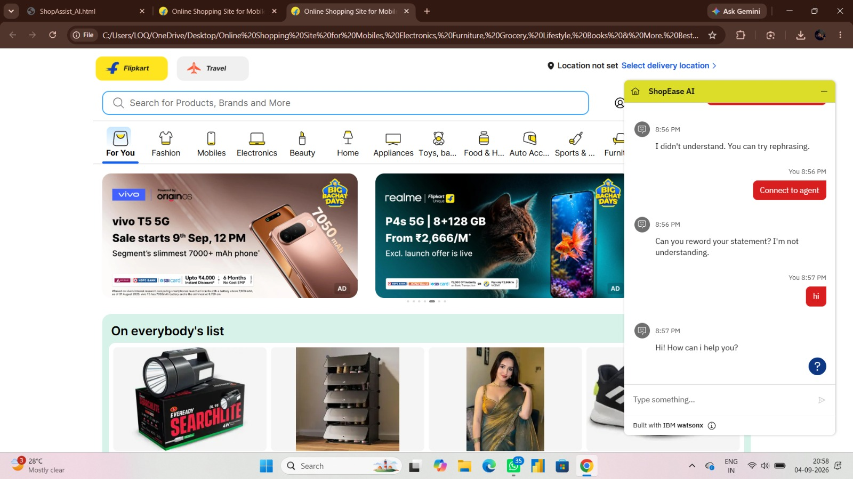
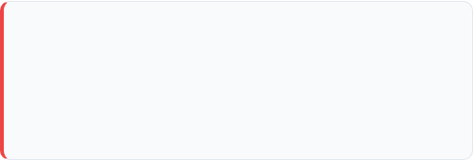
Step 8 • Production Deployment
Storefront Integration & Fallback Handling
Embedded in E-Commerce Storefront
Flipkart Storefront • ShopEase AI Live & Fallback
We embedded the ShopEase AI widget into a live retail storefront (Flipkart-style design) with real product categories, search bars, and promotional banners.
Smart Fallback & Agent Routing
When a customer message is unclear or unrecognized:
•
Friendly Guidance: "I didn't understand. You can try rephrasing."
•
Clarification: "Can you reword your statement?"
•
One-Click Escalation: High-visibility red button allows direct transfer to human support.

Slide 16


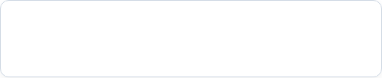
THANK YOU
Team Member Ritika Tyagi
Reg No: 12528797
Team Member
Rishabh Singh Bhadouriya
Reg No: 12523735

